Slide 1
Consave Consultants Pvt. Ltd
Creating Excellence
in
Cost and Construction Management Industry

Slide 2

Consave Consultants Pvt. Ltd
Consave Consultants Pvt. Ltd
Apki bachat ka vada

Slide 3
Key Personnel
Consave Consultants Pvt. Ltd
Sahar Alam
Designation : - Managing Director
Qualification : - B.E (Civil & Master in Construction Management)
Experience : - Around 25 Yrs
Moinuddin Ahmed Khan
Designation : - CTO
Qualification : - B. Tech Civil Engineer
Experience : - Around 25 Yrs
Kabir Sahni
Designation : - Civil Head
Qualification : - B. Tech Civil Engineer Experience : - Around 20 Yrs
Mohd Shaif Ali
Designation : - MEP Head
Qualification : - B. Tech Electrical Engineer
Experience : - Around 13 Yrs

Slide 4
Key Personnel
Consave Consultants Pvt. Ltd
Ruhil Khan
Designation : - General Manager - Civil
Qualification : - B. Tech Civil Engineer Experience : - Around 22 Yrs
Mohd Shoaib
Designation : - Tendering & Budgeting Head
Qualification : - B. Tech Civil Engineer
Experience : - Around 15 Yrs
Zafar Iqbal
Designation : - Sr. Project Manager - Civil
Qualification : - B. E Civil Engineer
Experience : - Around 16 Yrs
Bilal Ahmad Zuberi
Designation : - HVAC Head
Qualification : - B. Tech Mechanical Engineer
Experience : - Around 10 Yrs

Slide 5
Team Details
Consave Consultants Pvt. Ltd
Sanjeevni Gupta - Design Architect
Sibtain Khan - BDM
Aftab Alam - General Manager
Inteqhab Alam - General Manager
Farhan Khan - Sr. Project Manager
Tabrez Khan - Project Manager
Athar Alam - Sr. Project Engineer
Mehar Alam - Sr. Project Engineer
Afroz Ahmed - Sr. Project Engineer
Khawar Khan - Sr. Quantity Surveyor
Shaf Faisal - Sr. Quantity Surveyor
Vijay Bansiwal - Quantity Surveyor
Nikita Dubey - Quantity Surveyor
Mahroof Ahmad - Quantity Surveyor
Asif Khan - Quantity Surveyor
Anas Khan - Quantity Surveyor

Slide 6
Key Personnel Experience
Consave Consultants Pvt. Ltd
Sahar Alam
Managing Director of Consave Consultants Pvt. Ltd.
Around 25 years of experience in the Civil Industry. He has played an instrumental role in delivering a number of real estate projects across India like Hospitals, Hotels, High Rise Buildings, Commercial & Industrial Projects.
He has associated and offered his services to some of the Big projects like, Medanta Hospital Gurgaon,, Amrita Hospital Faridabad, Alchemist Punchkula, Select City Walk New Delhi and list goes on.
Moinuddin Ahmed Khan
Chief Technical Officer of Consave Consultants Pvt. Ltd.
Above 25 years of experience in the Civil Industry. He has done multiples Projects like Hospital, Hotels, High Rise Buildings & Commercial office Buildings.
He has associated to some of the Big projects like, Medanta Hospital Gurgaon,,Godrej Properties and list goes on.
.

Slide 7
Key Personnel Experience
Consave Consultants Pvt. Ltd
Ruhil Khan
General Manager of Consave Consultants Pvt. Ltd.
Around 22 years of experience in the Civil Industry. He was acting as a Project head controlling & Managing the Project in coordination with all stakeholder since commencement to completion with refrain from hiccups of Design, drawing, cash flow, execution, contractual lacunas for Civil, MEP & finishing works of Green field as well as high end finishes Projects like Hotel Project, Residential, Commercial Project & IT Towers independently. He has associated to some of the Big Projects like Radison Hotel Ghaziabad,
Mohammad Shaif Ali
MEP Head of Consave Consultants Pvt. Ltd.
Above 13 years of experience in the MEP works. He has done multiples Projects like Hospitals, Hotels, High Rise Buildings & Commercial office Buildings.
He has associated to some of the Big Projects like, Bhutani Infra, Good Living Bhutani High end residence, Godrej South Estate, Godrej Habitat, OSP Farm House, ASP Farm House, Kartick Nagpal Farm House, Merigold Residence, Omaxe and list goes on.

Slide 8
Key Personnel Experience
Consave Consultants Pvt. Ltd
Zafar Iqbal
Sr. Project Manager of Consave Consultants Pvt. Ltd.
Around 16 years of experience in the Civil Industry. He was acting as a Sr. Project Engineer. He has done multiples projects like High Rise Residential, Industrial, Airports, Container Yards & Commercial Project independently.
Mohd Shoaib
Tendering & Costing Head of Consave Consultants Pvt. Ltd.
Above 15 years of experience in the Civil works. He has done multiples Projects like High Rise Residential, Hospitals & Commercial Buildings.
He has associated to some of the Big Projects like Bhutani Infra, Good Living Bhutani High end residence, Godrej South Estate, Godrej Habitat, OSP Farm House, ASP Farm House, Kartick Nagpal Farm House, 6 Oak Drive Farm House, Camellieas Flat HCL, Omaxe and list goes on.
Bilal Ahmed Zuberi
HVAC Head of Consave Consultants Pvt. Ltd.
Around 10 years of experience in the HVAC Industry. He was acting as a Sr. Project Engineer. He has done multiples projects like Jaipuria Farm House, Kartick Nagpal Farm House, 6 Oak Drive Farm House independently.

Slide 9
OUR SERVICES
Consave Consultants Pvt. Ltd
MEP Design
Contracts Management
Quality & Safety Audit
Quantity Surveying
Cost Management
Technical & Financial Bill Audit
Project Management

Slide 10
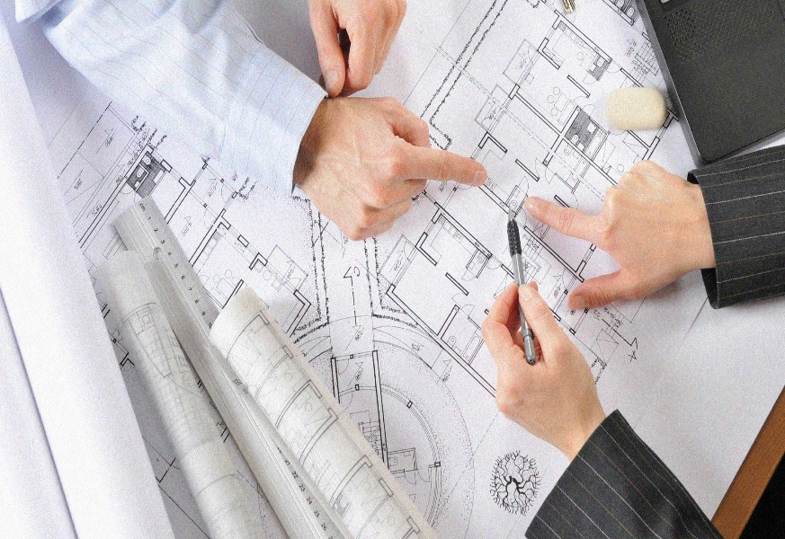
Project Management
Consave Consultants Pvt. Ltd
Judicious planning of time & resources.
Review the project schedule by means of different software tools i.e Primavera / MS Project.
Strict Implementation of SOPs customized for the project.
Enhance quality control to reduce potential for defects and poor workmanship.
Provide realistic and reliable budgets.
Optimize and accelerate the design and construction schedule.
Protect the Owner from unnecessary liability.

Slide 11

Contract/Tender Management
Consave Consultants Pvt. Ltd
  Preparing/Vetting of BOQ, Technical Specs, List of makes, General & Special Conditions of Contracts.
  Ensuring the correct Pre Qualification of Vendors.
  Preparing/Floating Tender to correct prequalifies vendors.
  Preparing Technical & Commercial Bid Comparative.
  Managing Transparent Negotiation Meeting with vendors.
  Ensuring all Legal, NGT, Labour Laws, Government Compliances.
  Preparation of Contract Document.

Slide 12

Technical & Financial Bill Audit
Consave Consultants Pvt. Ltd
  Ensure correctness of claimed quantities.
  Ensure the execution of items as per item description.
  Ensure the correctness of the payment made to the Contractors.
  Ensure the correctness of commercial terms & conditions.
  Explore the hidden saving.
  Find computation error in the documents.

Slide 13

Quantity Surveying
Consave Consultants Pvt. Ltd
Give a good budget at the start of the job and so long as there are no major changes during the project that should be the final cost.
Help in preventing overspending.
To give current cost at all stages of the project.
Advising on the cost changes.
Dealing with contractors’ valuations and claims.

Slide 14

Cost Management
Consave Consultants Pvt. Ltd
  To ensure project is completed within budget.
  Reduces the costs expended by a client while strengthening their strategic position.
  Strategic procurement advice helps in making effective procurement decisions.
  No overspending hence increase revenue and profit.
  Identify any potential risk associated with the project and make a realistic financial provisions

Slide 15
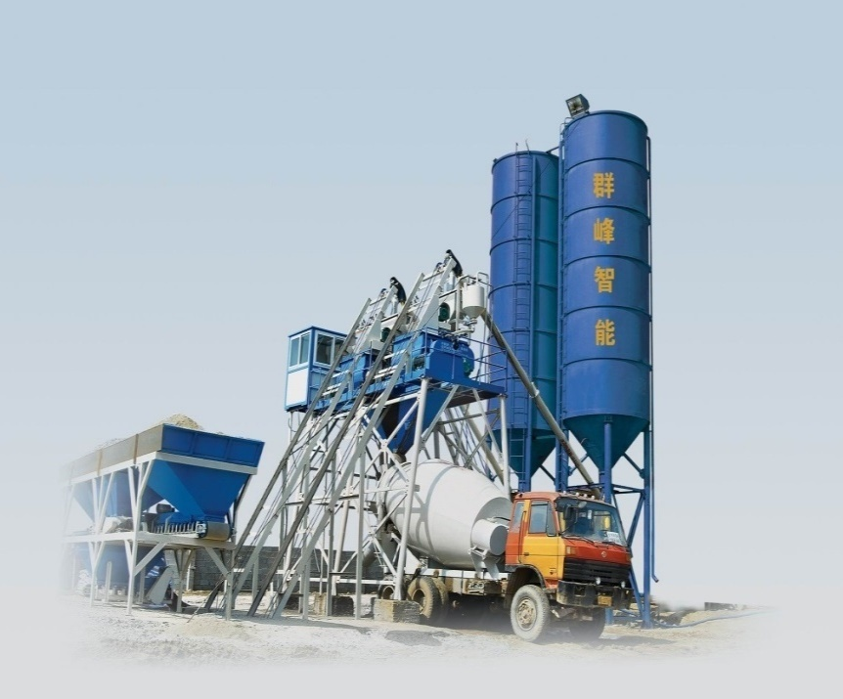
Quality & Safety Audit
Consave Consultants Pvt. Ltd
  Ensure the execution of items as per item description.
  Ensure the implementation of quality assurance plan.
  Verify all the Site test & laboratory records.
  To ensure safety policies.
  To ensure implementation of safety assurance plan.

Slide 16
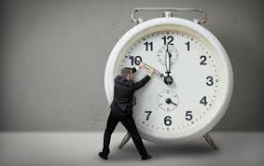
Schedule Management
Consave Consultants Pvt. Ltd
Providing Critical Path for the sequence of activities of the project.
Developing , analyzing, updating and monitoring project schedules and reporting procedures.
Saving on Direct & Indirect cost levied due to delay of project.
Saving project from Mismanagement of time and threat to the goodwill of the organization

Slide 17
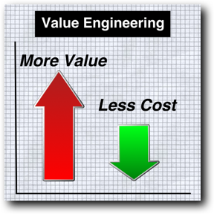
Value Engineering
Consave Consultants Pvt. Ltd
  Optimization of Design at concept stage.
  Optimization of Structure System.
  Optimization of MEP Design
  Optimization of Cost in procurement of Materials.
  Optimization of wastage of materials.

Slide 18
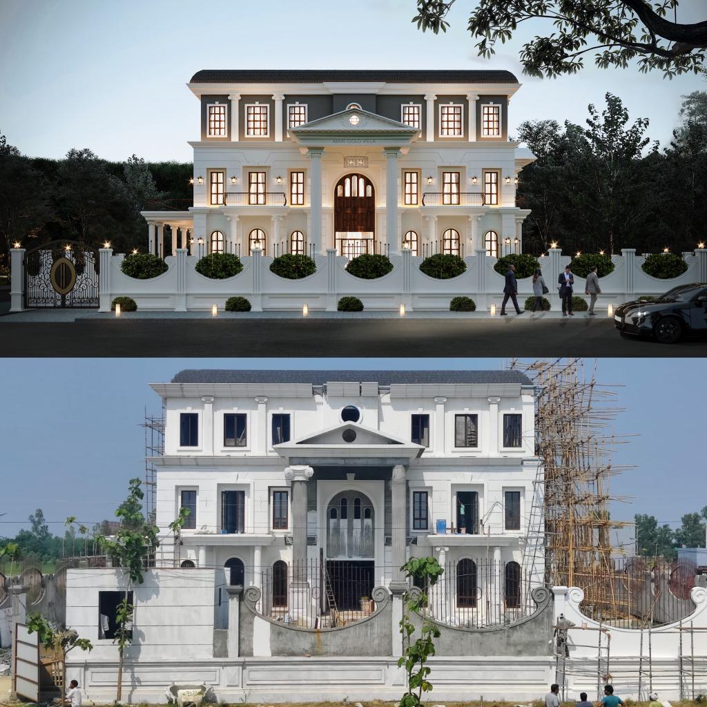
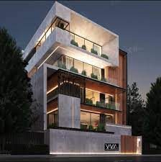
Projects In Hand - PMC
Consave Consultants Pvt. Ltd
  Project Name : - Nagpal Farm House
  Location : - Sultanpur New Delhi
  Area of Project : - 15000 Sqft
  Project Cost : - Approx .15 Cr.
  Status – Works in Progress
  Project Name : - Marigold Residence
  Location : - Rampur U.P
  Area of Project : - 13000 Sqft
  Project Cost : - Approx. 13 Cr.
  Status – Works in Progress
  Project Name : - Justice Vibhu Bakhru
  Location : - Defense Colony New Delhi
  Area of Project : - 12000 Sqft
  Project Cost : - Approx. 8 Cr.
  Status – Works in Progress

Slide 19
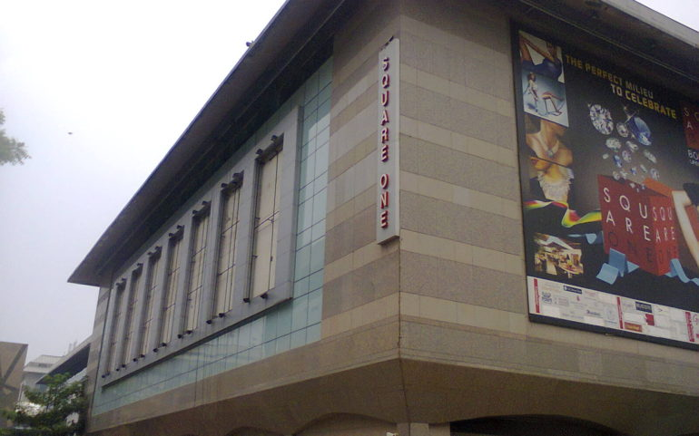
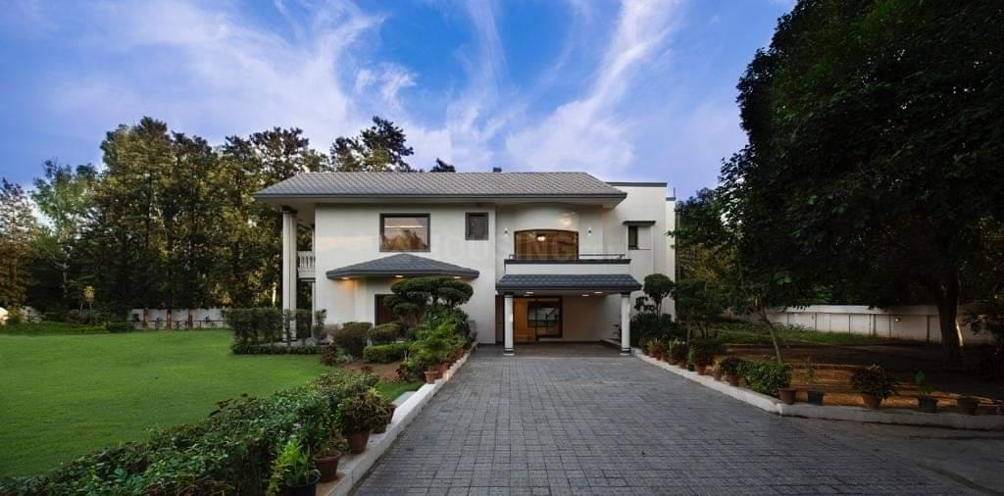
Projects In Hand - PMC
Consave Consultants Pvt. Ltd
  Project Name : - Square One Commercial
  Location : - Saket New Delhi
  Area of Project : - 1.5 Lac Sqft
  Project Cost : - Approx. 20 Cr.
  Status – Works in Progress
  Project Name : - 6 Oak Drive Farm House
  Location : - Chattarpur New Delhi
  Area of Project : - 30000 Sqft
  Project Cost : - Approx. 25 Cr.
  Status – Works in Progress

Slide 20
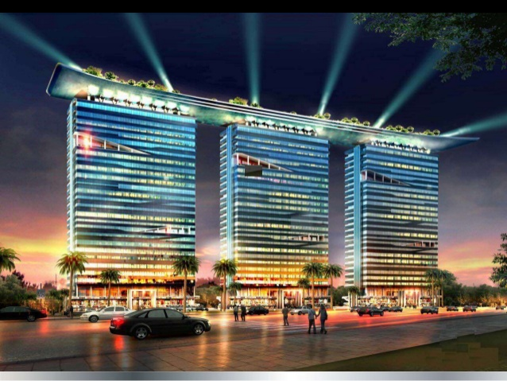
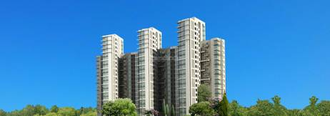
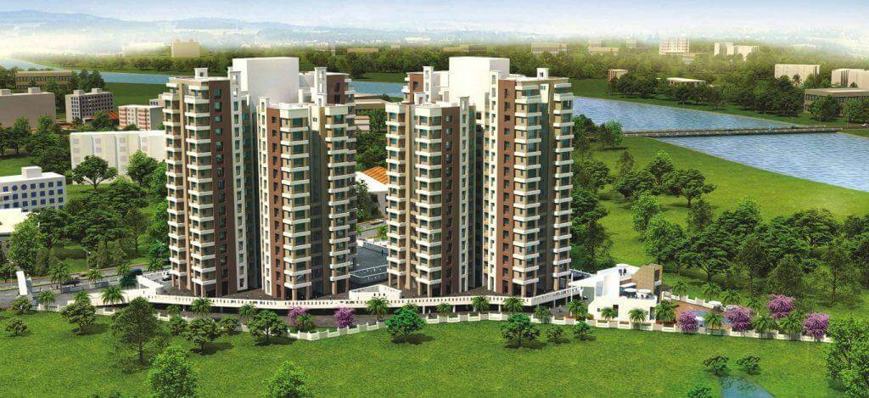
Projects In Hand - Cost/Bill Audit/QS Consultant
Consave Consultants Pvt. Ltd
  Project Name : - Bhutani Alphathum
  Location : - Sec 90 Noida
  Area of Project : - 50 Lac Sqft
  Project Cost : - 1250 Cr
  Status – Works in Progress
  Project Name : - Good Living Bhutani
  Location : - Jaypee 58 Noida
  Area of Project : - 1.5 Lac Sqft
  Project Cost : - 40 Cr
  Status – Works in Progress
  Project Name : - Godrej South Estate
  Location : - New Delhi
  Area of Project : - 09 Lac Sqft
  Project Cost : - 250 Cr
  Status – Works in Progress

Slide 21
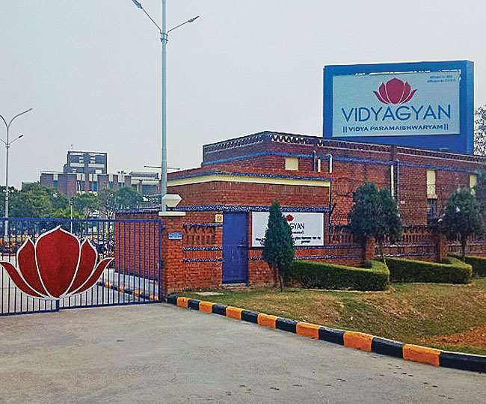
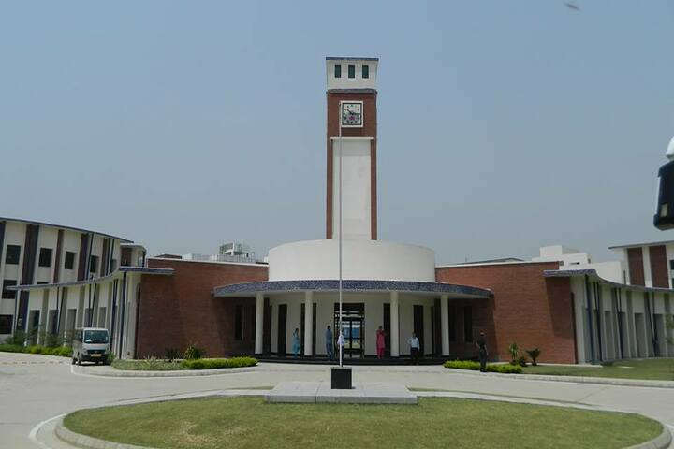
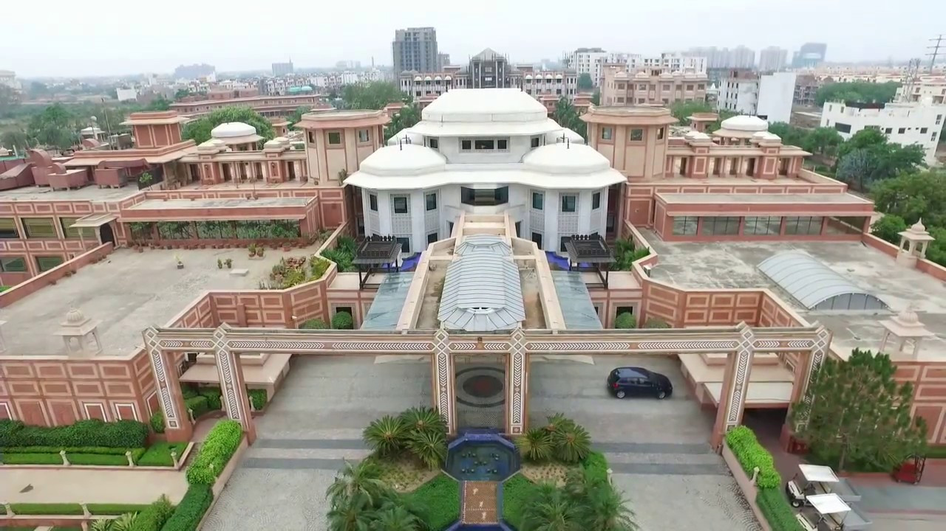
Consave Consultants Pvt. Ltd
Projects In Hand - Cost/Bill Audit/QS Consultant
  Project Name : - HCL Vidyagyan
  Location : - Sikandrabad, U.P
  Area of Project : - Approx 10 Lac Sqft
  Project Cost : - 50 Cr
  Status – Works in Progress
  Project Name : - HCL Vidyagyan
  Location : - Sitapur Lucknow
  Area of Project : - Approx 10 Lac Sqft
  Project Cost : - 50 Cr
  Status – Works in Progress
  Project Name : - Modarch -Refurbishment of Resort
  Location : - Agra
  Area of Project: - 15 Acre
  Project Cost : - Approx 10 Cr
  Status – Works in Progress

Slide 22
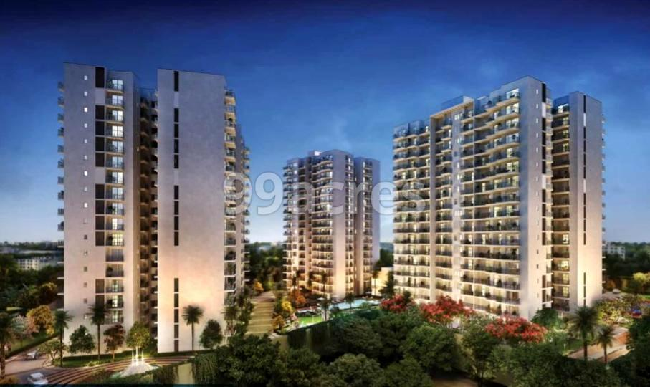
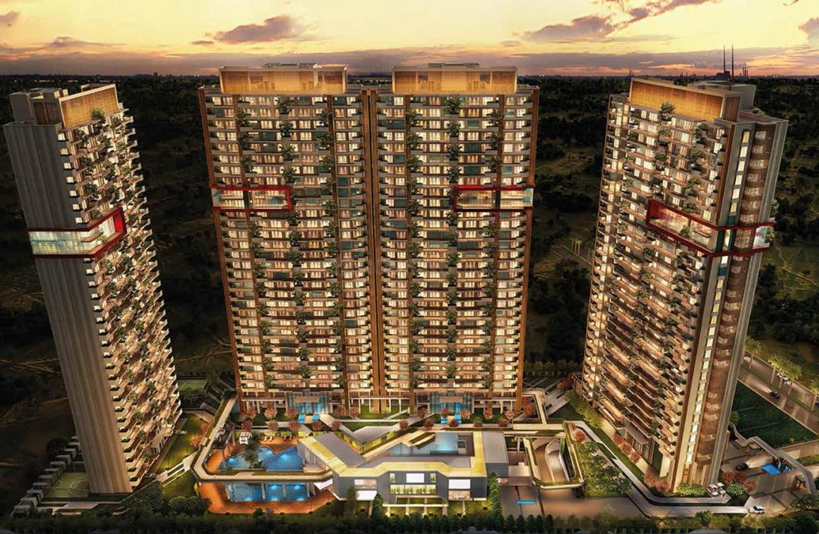
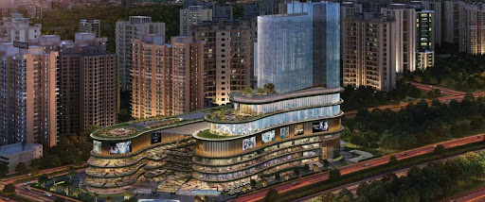
Consave Consultants Pvt. Ltd
Projects In Hand - Cost/Bill Audit/QS Consultant
  Project Name : - Godrej Habitate
  Location : - Gurgaon
  Area of Project : - 13 Lac Sqft
  Project Cost : - 350 Cr
  Status – Works in Progress
  Project Name : - Mahagun Residency
  Location : - Sector 107 Noida
  Area of Project : - 27 Lac Sqft
  Project Cost : - 400 Cr
  Status – Works in Progress
  Project Name : - Mahagun Millenia Mall
  Location : - Noida
  Area of Project : - 3 Lac Sqft
  Project Cost : - 75 Cr
  Status – Works in Progress

Slide 23
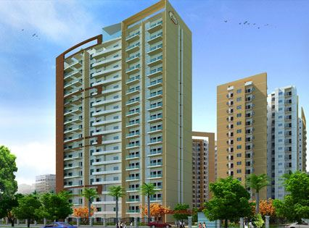
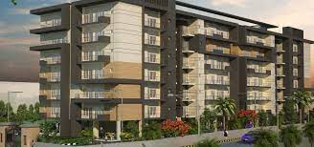
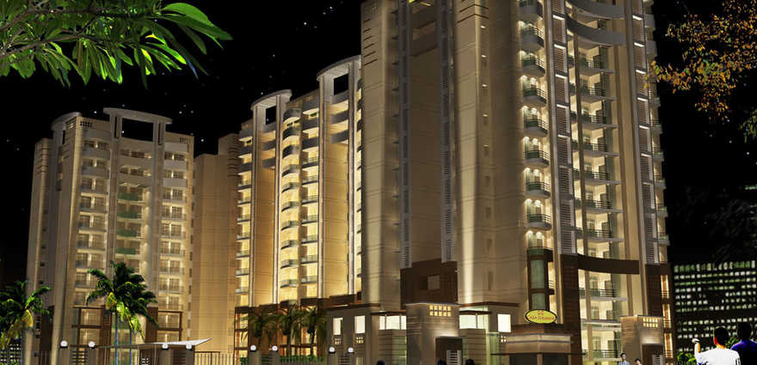
Consave Consultants Pvt. Ltd
Completed Projects - PMC Consultant /Cost/Bill Audit/QS Consultant
  Project Name : - Mega County
  Location : - Dehradoon
  Area of Project : - 5 Lac Sqft
  Project Cost : - 100 Cr
  Status – Completed
  Project Name : - Rajpur Green
  Location : - Dehradoon
  Area of Project : - 5Lac Sqft
  Project Cost : - 90Cr
  Status – Completed
  Project Name : - Casa Grande I Residency
  Location : - Greater Noida
  Area of Project : - 6.5 Lac Sqft
  Project Cost : - 120 Cr
  Status – Completed

Slide 24
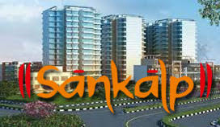
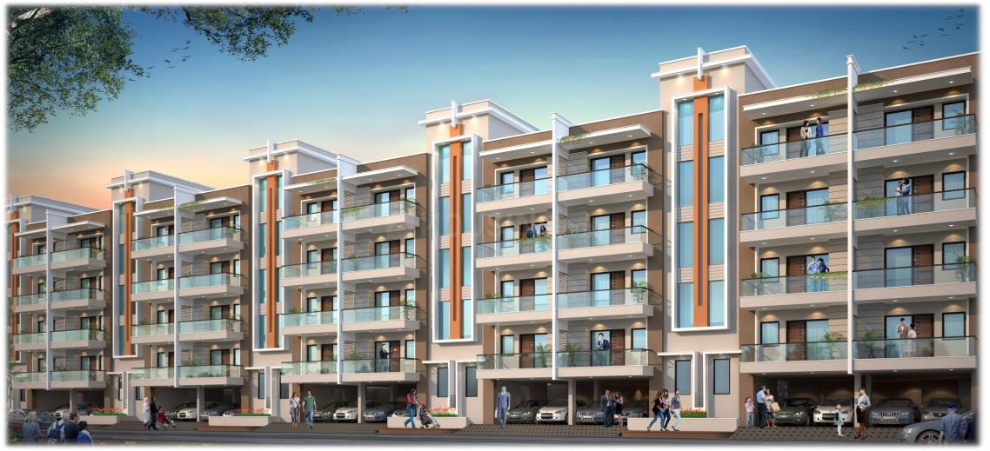
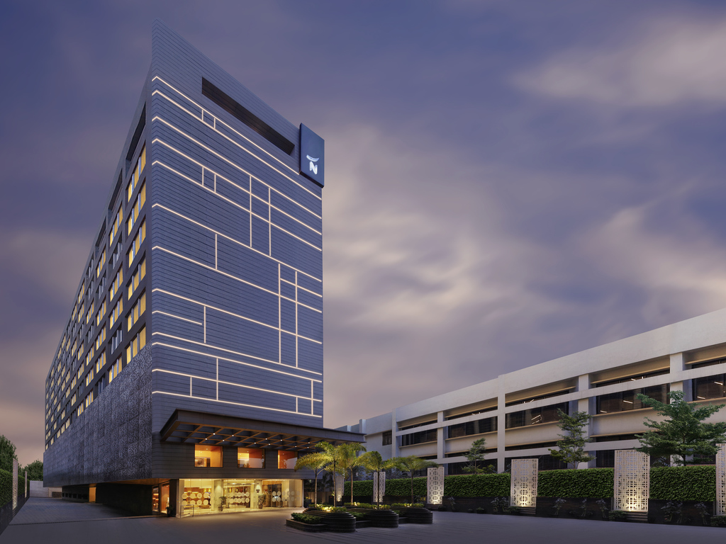
Consave Consultants Pvt. Ltd
Completed Projects - PMC Consultant /Cost/Bill Audit/QS Consultant
  Project Name : - Sankalp Residency
  Location : - Sec 85 Faridabad
  Area of Project : - 9 Lac Sqft
  Project Cost : - 135 Cr
  Status – Completed
  Project Name : - Amolik Residency
  Location : - Sec 86 Faridabad
  Area of Project : - 9 Lac Sqft
  Project Cost : - 100 Cr
  Status – Completed
  Project Name : Novotel Hotel
  Location : - Guwahati
  Area of Project : - 3 Lac Sqft
  Project Cost : - 100 Cr
  Status – Completed

Slide 25

















OUR CLIENTS
Consave Consultants Pvt. Ltd

Slide 26



OFFICE ADDRESS
Consave Consultants Pvt. Ltd
A-21 New Friend Colony New Delhi
Info.consave.md@gmail.com
Info@consave.in
9899259786, 9891416846

Slide 27
Consave Consultants Pvt. Ltd
Our Time saves your Money…
Thank you…

